Slide 1


Slide 2

Break The BriX
Presented By:->
Humayra Afia ID: 221002338

Slide 3
Contents
01
02
03
04
05
06
Introduction
Objectives
Implementa-tion
Result
Limitations
Future scope of Work

Slide 4
01
Introduction

Slide 5


01
Overview
Motivation
The Break The BriX game is a classic arcade-style game that involves breaking bricks with a ball and a paddle.
Building a game like Break The BriX provides an opportunity to explore the graphical user interface (GUI).

Slide 6
02
Objectives

Slide 7

02
Developing a user-friendly interface that is easy to use and understand.
To create agame that is engaging, challenging, and fun for players of all ages.
provide a challenging and enjoyable experience for the player.
compatible with various platforms and devices.

Slide 8
03
Implementation

Slide 9
03
Features My Game has
Game Board
Bricks
Paddle
Ball
Scoring System
Lives

Slide 10
Tools and Technologies Used:
Java programming language
Swing library for GUI
Visual Studio Code

Slide 11
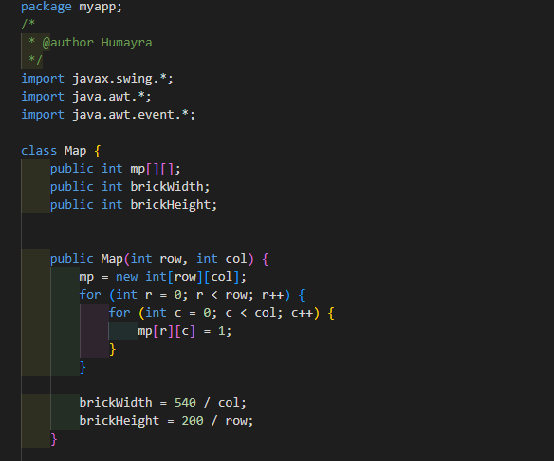
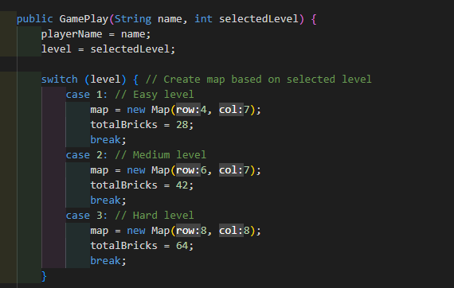

Slide 12
04
Result

Slide 13
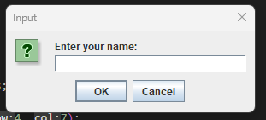
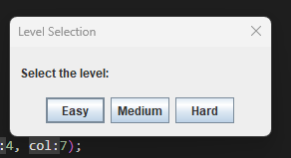
04
Result
First player has to enter his/her name
Select a level

Slide 14
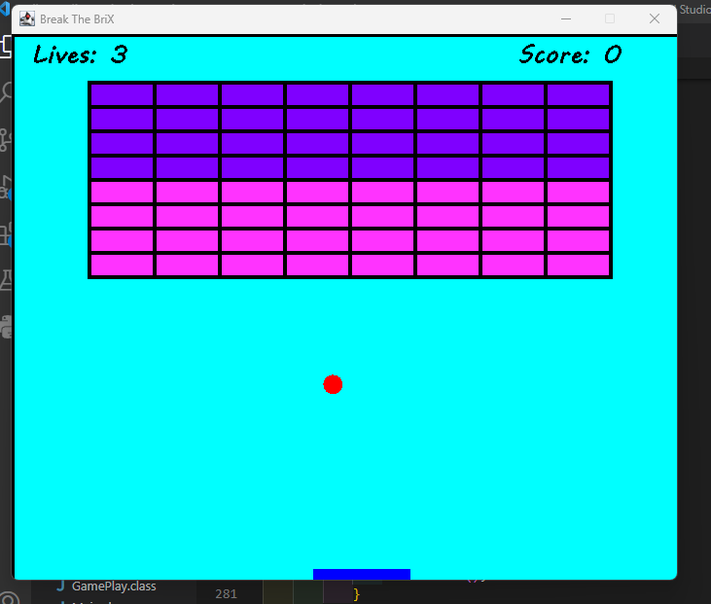
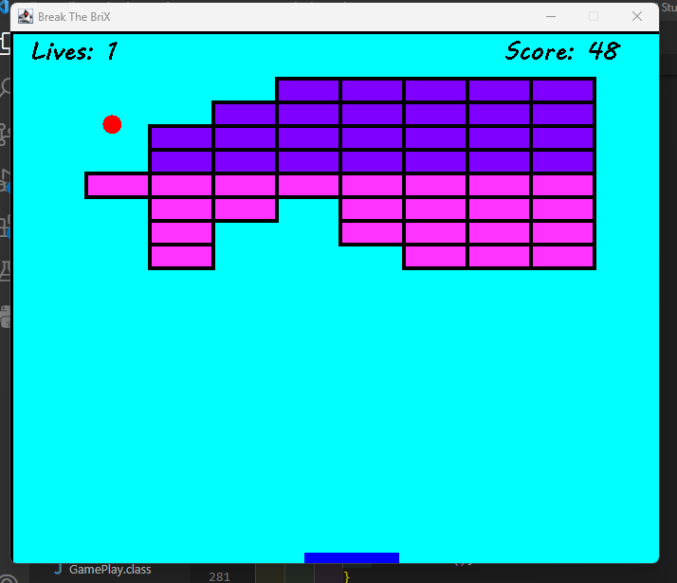

Slide 15
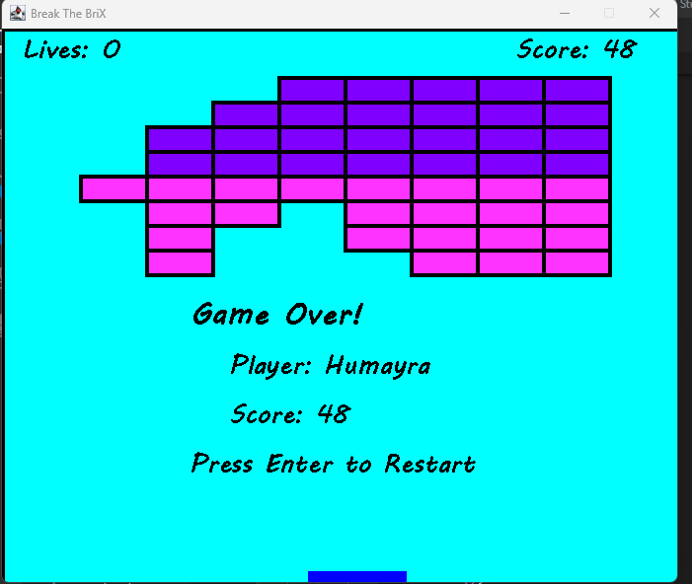
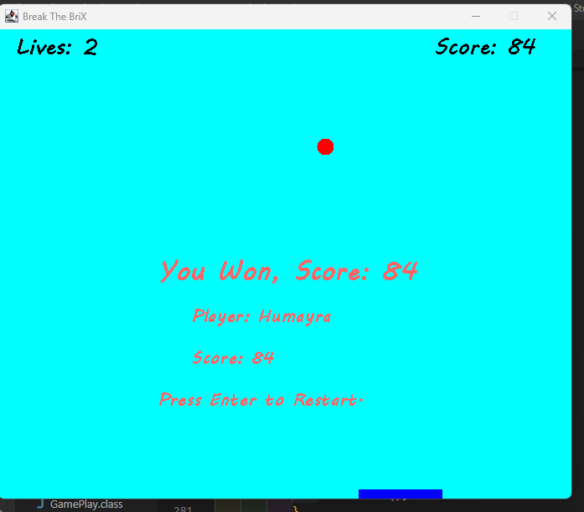

Slide 16
Limitations:
The game currently has a fixed layout and predefined levels.
It does not provide the option for custom levels or dynamic level generation.
The game lacks sound effects and background music, which could enhance the gaming experience.
The game does not have a high score tracking or leaderboard feature.

Slide 17
Future Scope Of Work:
Add sound effects and background music to enhance the gaming experience.
Implement a high score tracking system and leaderboard.
Introduce power-ups or special bricks to add more variety and challenges to the game.
Implement level editor functionality to allow users to create custom levels

Slide 18
Thank You

